Slide 1
影像處理、電腦視覺及深度學習概論 (Introduction to Image Processing, Computer Vision and Deep Learning) Homework 2
TA:
少鈞: nckubot65904@gmail.com
Office Hour: 14:00~16:00, Mon.
10:00~12:00, Fri.
At CSIE 9F Robotics Lab.

Slide 2
Notice (1/2)
Copying homework is strictly prohibited!! Penalty: Score will be zero for both persons!!
Due date => 09:00:00, 2022/12/12 (Mon.)
No delay. Penalties for late homework:
Up to 7 days late, loss of 50% of the score awarded
After 7 days, the score will be marked as 0.
You must attend the demonstration, or your score will be 0. The demonstration schedule will be announced on NCKU moodle.
You must make a GUI and follow the format, or you will get some penalties.
Upload to => 140.116.154.1 -> Upload/Homework/Hw2
Upload/Homework/Hw2_05
User ID: opencvdl2022 Password: opencvdl2022
Format
Filename: Hw2_StudentID_Name_Version.rar
Hw2_05_StudentID_Name_Version.rar
Ex: Hw2_F71234567_林小明_V1.rar
If you want to update your file, you should update your version to be V2.
Ex: Hw2_F71234567_林小明_V2.rar
Content: project folder*( excluding the pictures, only source code ) *note: remove your “Debug” folder to reduce file size

Slide 3
Notice (2/2)
Python
Python 3.7 (https://www.python.org/downloads/)
opencv-contrib-python (3.4.2.17)
Matplotlib 3.1.1
UI framework: pyqt5 (5.15.1)

Slide 4
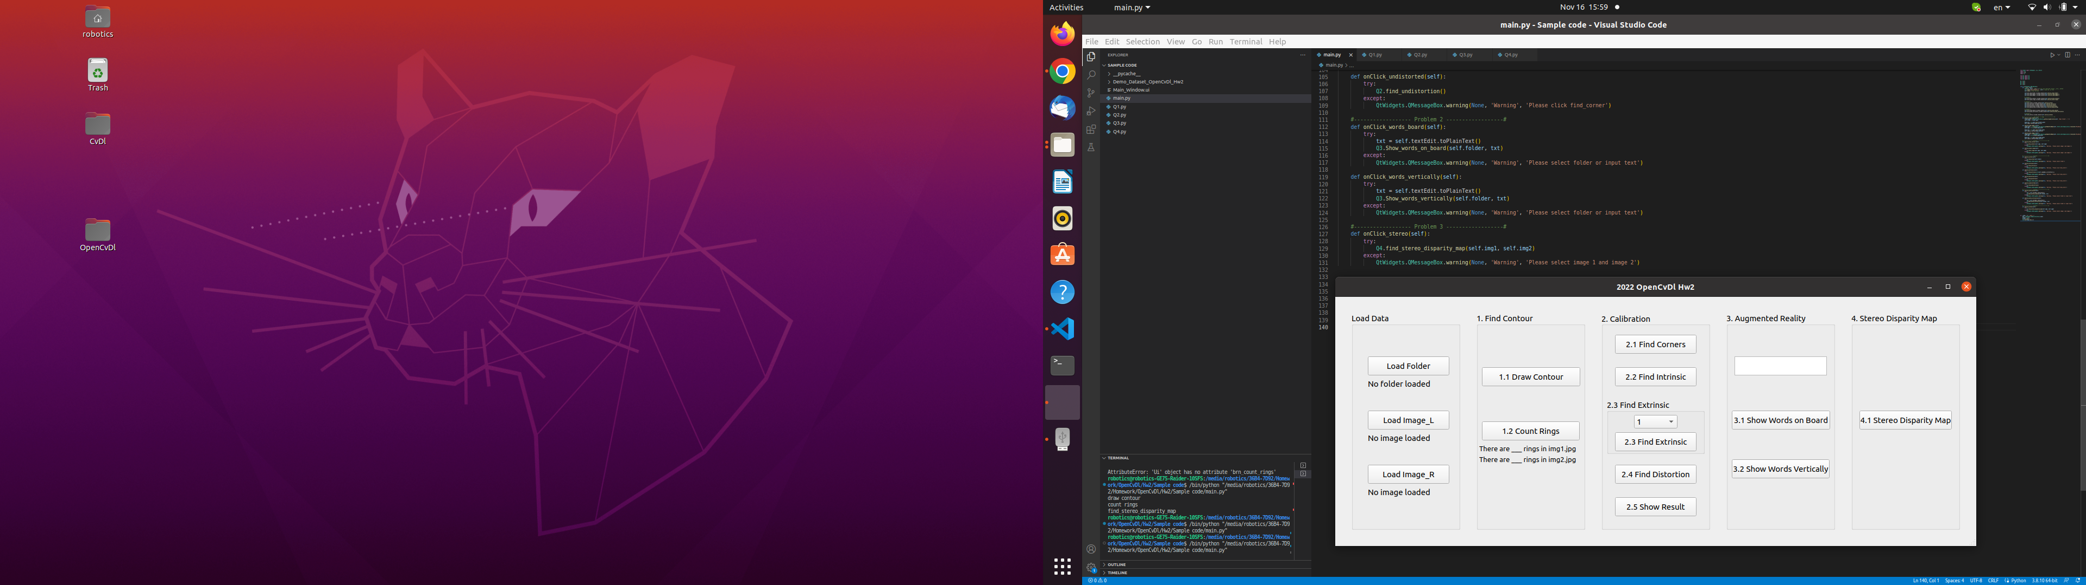
Assignment scoring (Total: 100%)
(出題：Mei)
1. (20%) Image Processing
1.1 (15%) Draw Contour
1.2 (5%) Count Rings
2. (20%) Camera Calibration
2.1 (4%) Corner detection
2.2 (4%) Find the intrinsic matrix
2.3 (4%) Find the extrinsic matrix
2.4 (4%) Find the distortion matrix
2.5 (4%) Show the undistorted result
3. (20%) Augmented Reality
3.1 (10%) Show words on board
3.2 (10%) Show words vertically
4. (20%) Stereo Disparity Map
4.1 (10%) Stereo Disparity Map
4.2 (10%) Checking the Disparity Value
5. (20%) Train a Cat-Dog Classifier Using ResNet50
5.1 (3%) Load the dataset and resize images
5.2 (3%) Plot class distribution of training dataset
5.3 (3%) Show the structure of ResNet50 model
5.4 (3%) Set up 2 kinds of loss functions to train 2 ResNet50 models
5.5 (3%) Compare the accuracies of 2 ResNet50 models on validation dataset
5.6 (4%) Use the better-trained model to run inference and show the predicted class label
(出題：Jessica)
(出題：Ming)
Don’t fix your data path
(There is another dataset for demonstration)
(出題：Maton)
(出題：Benjamin)
Question 5 needs to upload separately.

Slide 5
1. (20%) Find Contour
(出題：Mei)
1.1 (15%) Draw Contour
1.2 (5%) Count Rings

Slide 6
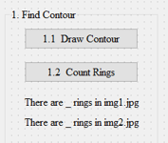
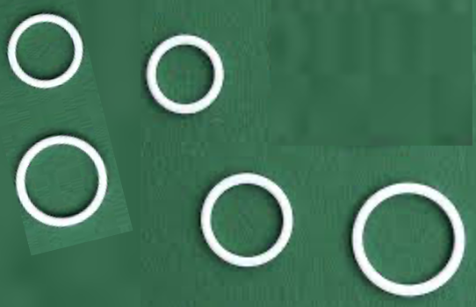
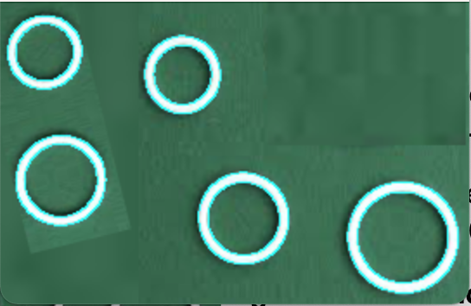
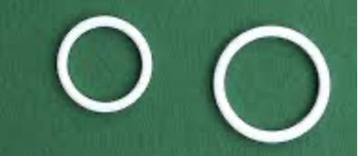
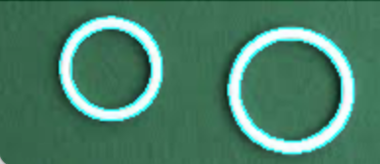
1.1 Find Contour – Draw Contour
(出題：Mei)
Given: two color images, “img1.jpg” and “img2.jpg”
Q: 1)
Hint: Textbook Chapter 8, p.234 ~ p.241
RGB ➔ Resize(1/2) ➔ Grayscale ➔ Binary
Remember to remove the noise. (use Gaussian Blur & other function)
Using some edge detection functions to get better results. (Ex: cv2.Canny)
Draw Contour: Using OpenCV functions to find the contours of rings in two images.
img1.jpg
Draw Contours
img2.jpg
Draw Contours

Slide 7
1.2 Find Contour – Count Rings
(出題：Mei)
Given: two color images, “img1.jpg” and “img2.jpg”
Q: 2)
Hint: Textbook Chapter 8, p.234 ~ p.241
Calculate how many rings (contour/2)
Count Rings: Using OpenCV functions to find how many rings in two images.
img1.jpg
img2.jpg

Slide 8
2. (20%) Camera Calibration
(出題：Jessica)
2.1 (4%) Corner detection
2.2 (4%) Find the intrinsic matrix
2.3 (4%) Find the extrinsic matrix
2.4 (4%) Find the distortion matrix
2.5 (4%) Show the undistorted result
Load all images in the folder

Slide 9
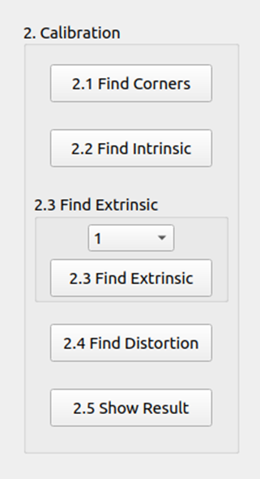
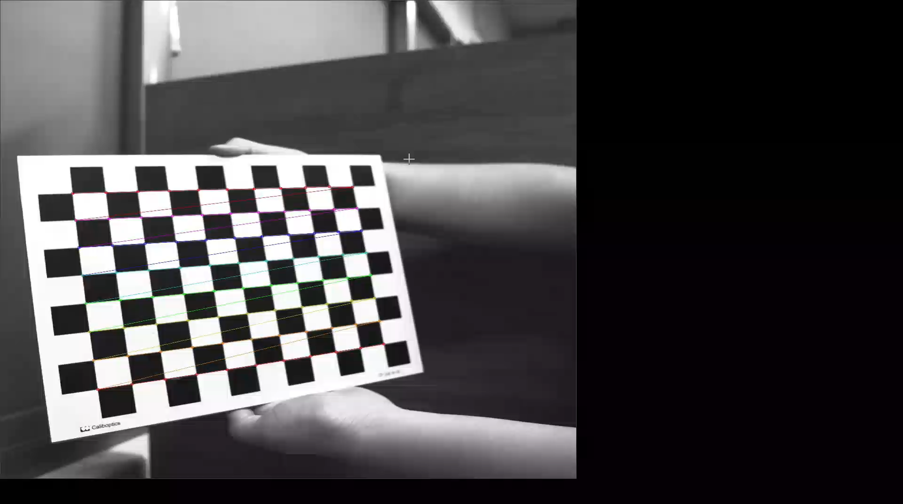
2.1 Corner Detection (4%)
(出題：Jessica)
Given: 15 images, 1.bmp ~ 15.bmp
Q: 1) Find and draw the corners on the chessboard for each image.
2) Click button “2.1” to show each picture 0.5 seconds.
Hint :
OpenCV Textbook Chapter 11 (p. 398 ~ p. 399)
cv.findChessboardCorners(…)
Ex:
9

Slide 10
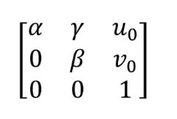
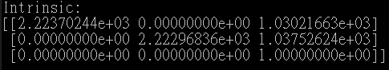
2.2 Find the Intrinsic Matrix (4%)
(出題：Jessica)
Given: 15 images, 1.bmp ~ 15.bmp
Q: 1) Find the intrinsic matrix ():
2) Click button “2.2” and then show the result on the console window.
Output format:
Hint: OpenCV Textbook Chapter 11 (P.398 ~ p.400)
(Just an example)

Slide 11
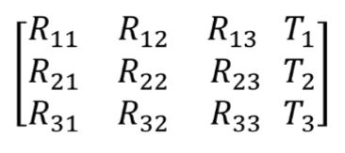
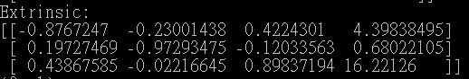
2.3 Find the Extrinsic Matrix (4%)
(出題：Jessica)
Given: Intrinsic parameters, distortion coefficients, and the list of 15 images
Q: 1) Find the extrinsic matrix of the chessboard for each of the 15 images, respectively:
2) Click button “2.3” and then show the result on the console window.
Output format:
Hint: OpenCV Textbook Chapter 11, p.370~402
(Just an example)
(1) List of numbers: 1~15
(2) Select 1, then 1.bmp will be applied, and so on

Slide 12
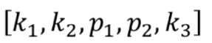
2.4 Find the Distortion Matrix (4%)
(出題：Jessica)
Given: 15 images
Q: 1) Find the distortion matrix:
2) Click button “2.4” to show the result on the console window.
Output format:
Hint:
Distortion coefficients can be obtained simultaneously with intrinsic parameters
OpenCV Textbook Chapter 11 (P.398 ~ p.400)
(Just
an example)

Slide 13
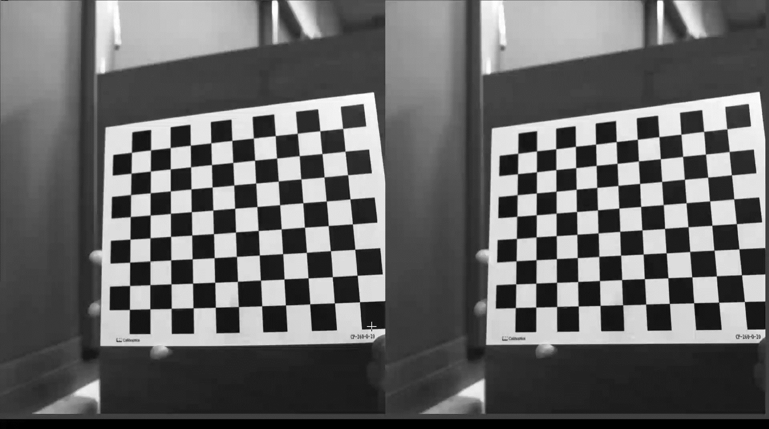
2.5 Show the undistorted result (4%)
(出題：Jessica)
Given: 15 images
Q: 1) Undistort the chessboard images.
2) Show each distorted and undistorted images 0.5 seconds.
Hint:
cv::undistort(…) or cv::initUndistortRectifyMap(…)
OpenCV Textbook Chapter 11 (P.398 ~ p.400)
Distorted image
Undistorted image

Slide 14
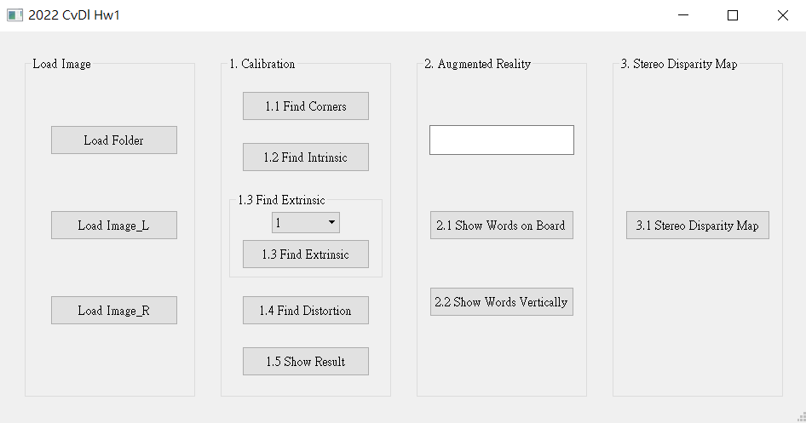
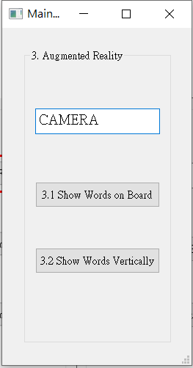
3. (20%) Augmented Reality
(出題：Ming)
3.1 (10%) Show words on board
3.2 (10%) Show words vertically
Load all images in the folder

Slide 15
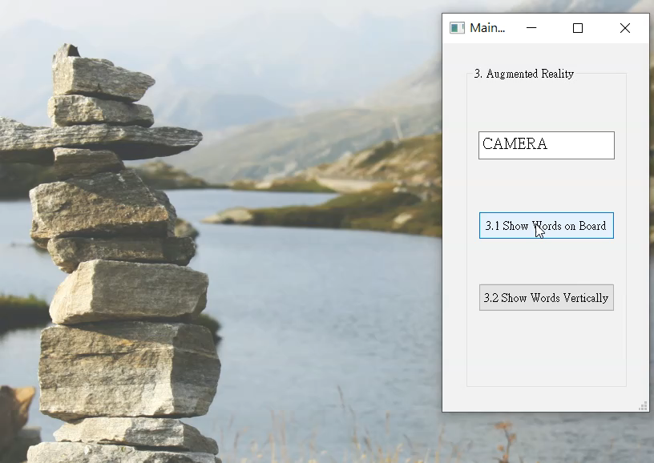
3. (20%) Augmented Reality
(出題：Ming)
Given: 5 images: 1~5.bmp
Q:
1) Calibrate 5 images to get intrinsic, distortion and extrinsic parameters
2) Input a “Word” less than 6 char in English in the textEdit box
3) Derive the shape of the “Word” by using the provided library
4) Show the “Word” on the chessboards images(1.bmp to 5.bmp)
5) Show the “Word” vertically on the chessboards images(1.bmp to 5.bmp)
6) Click the button to show the “Word” on the picture. Show each picture for 1 second (total 5 images)
Demo:
Hint : Textbook Chapter 11,
p.387~395 Calibration
p.405~412 Projection
cv2.calibrateCamera()
cv2.projectPoints()

Slide 16
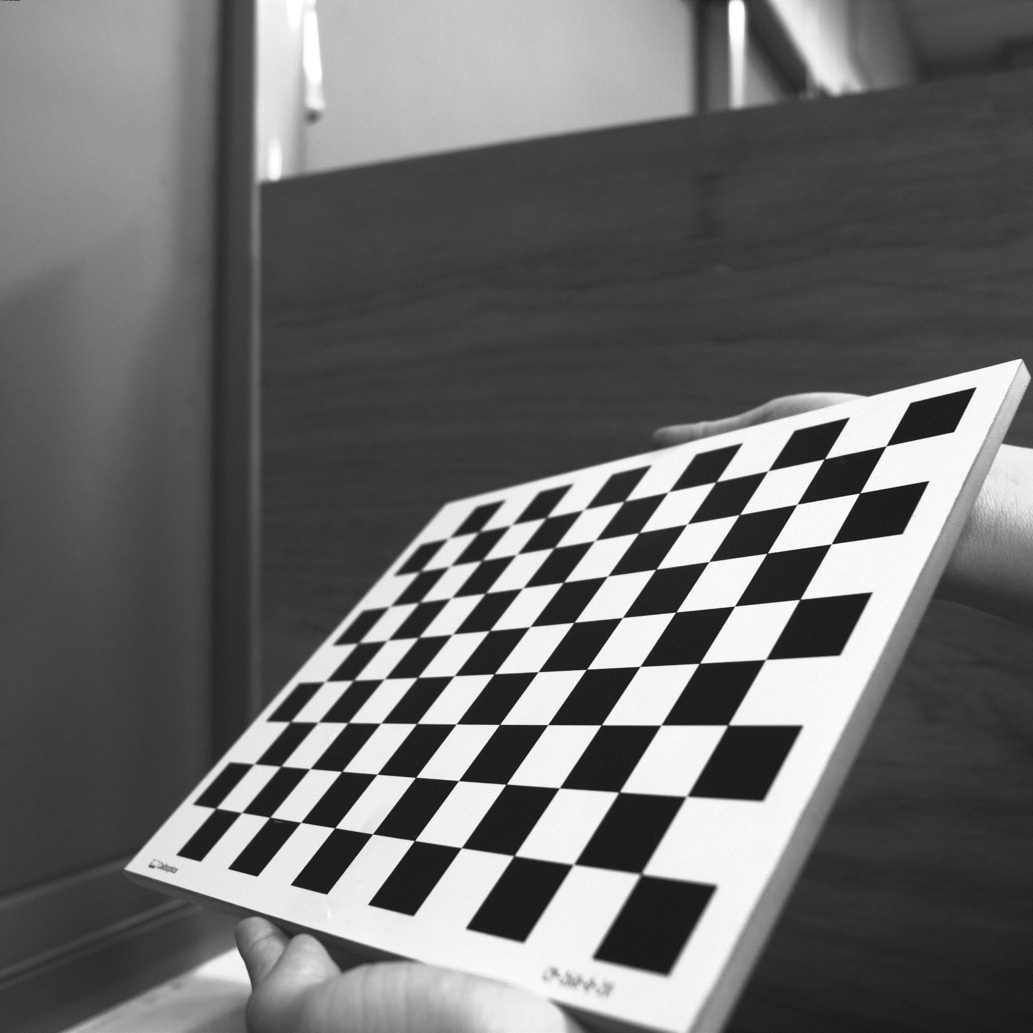
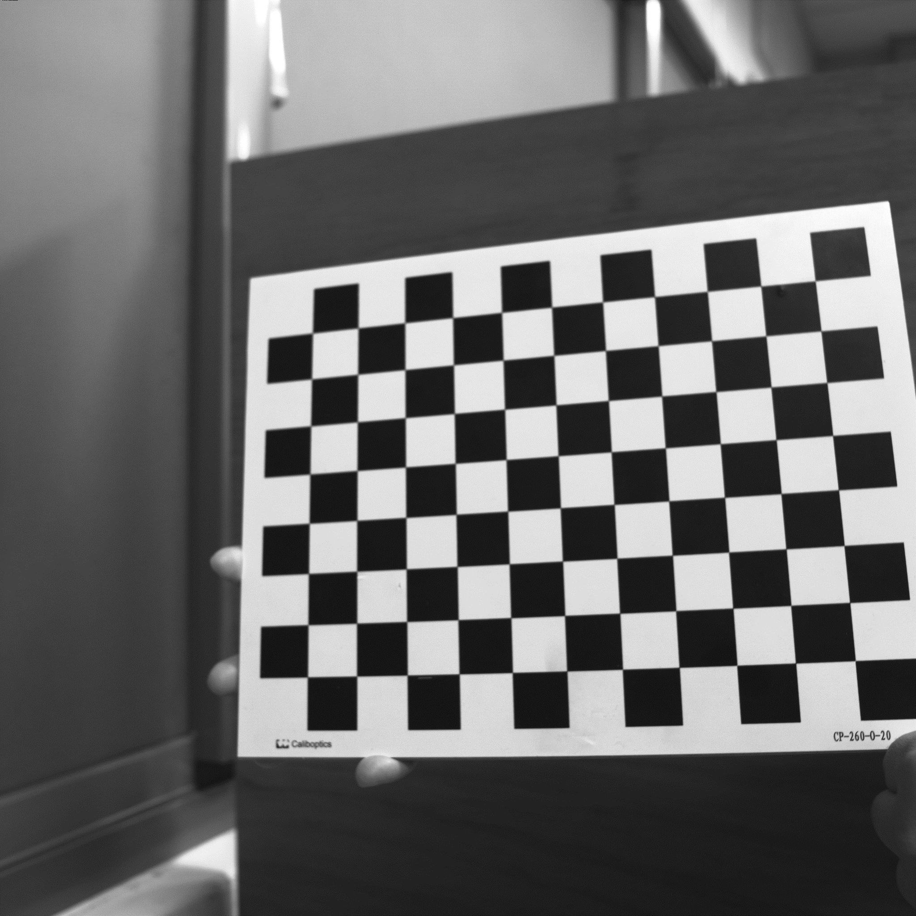
3. (20%) Augmented Reality
(出題：Ming)
Guides and Requirements:
How to use the library: (alphabet_lib_onboard.txt, alphabet_lib_vertical.txt)
Use OpenCV function to read and derive the array or matrix of the char Here take ‘K’ in 'alphabet_lib_onboard.txt' for example Ex (Python): fs = cv2.FileStorage('alphabet_lib_onboard.txt', cv2.FILE_STORAGE_READ) ch = fs.getNode(‘K’).mat() ➔ get the lines of ‘K’
ch = [[[2, 2, 0], [2, 0, 0]], [[0, 2, 0], [2, 1, 0]],
[[2, 1, 0], [0, 0, 0]]]
‘K’ consist of 3 lines, so the ‘ch array’ consists 3 pairs of 3D coordinates in Word Frame representing two ends of the line shown in the upper right image.
Chessboard Coordinates
The chessboard x, y, z axis and (0,0,0) coordinate are shown in the bottom left image
Each Char should be place in the order and position shown in the bottom right image
(2,2,0)
(0,2,0)
(2,1,0)
(2,0,0)
(0,0,0)
The coordinates are in Word Frame
(0,0,0)
1
2
3
Y
4
5
6
X
Z
Chessboard Frame
Position and Order

Slide 17
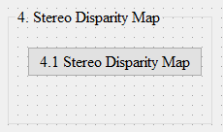
4. (20%) Stereo Disparity Map
(出題：Maton)
4.1 (10%) Stereo Disparity Map
4.2 (10%) Checking the Disparity Value
Load 2 images separately

Slide 18
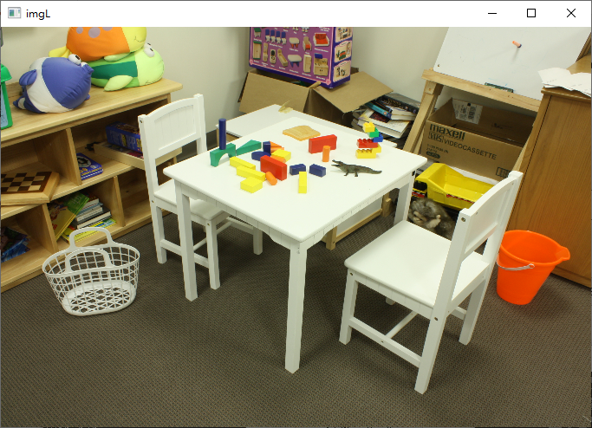
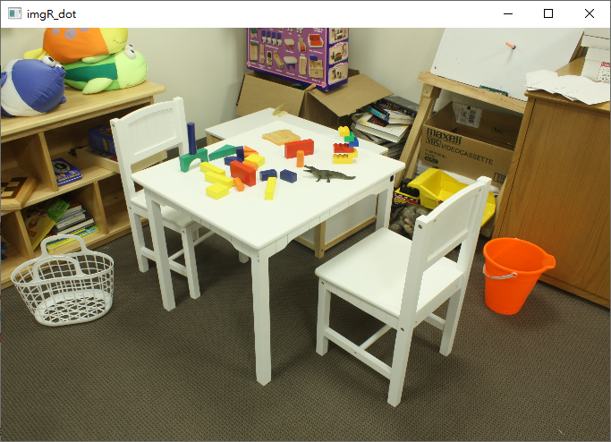
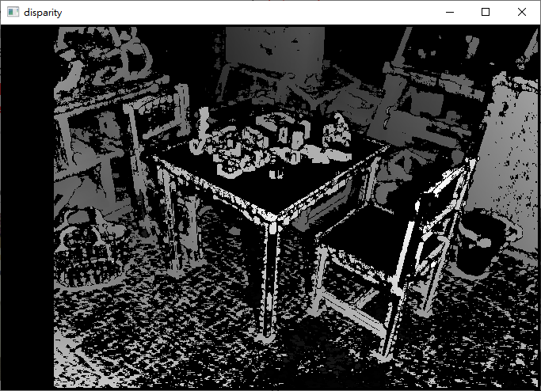
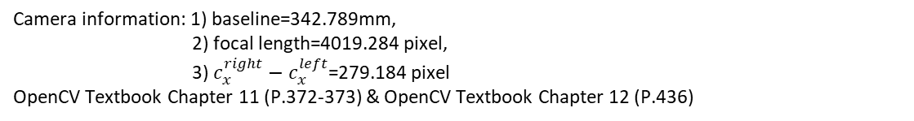
4.1 (10%) Stereo Disparity Map
(出題：Maton)
Given: a pair of images, imL.png and imR.png (have been rectified)
Q:
Find the disparity map/image based on Left and Right stereo images
Guides:
(1) Window Size: Must be odd and within the range [5, 255]
(2) Search range and direction:
Disparity range:
Must be positive and divisible by 16.
Map disparity range to gray value range 0~255 for the purpose of visualization.
If the left image is the reference image (the one used to cal. depth info for each pixel of that Img), then the search direction at right image will go from the right to left direction.
Camera information: 1) baseline=342.789mm,
2) focal length=4019.284 pixel,
3) $c_{x}^{right}−c_{x}^{left}$=279.184 pixel
OpenCV Textbook Chapter 11 (P.372-373) & OpenCV Textbook Chapter 12 (P.436)
Hint: OpenCV Textbook Chapter 12 (P.451)
StereoBM::create(256, 25)
imL.png
imR.png
Result
Left Image (Reference Image)
Right Image

Slide 19
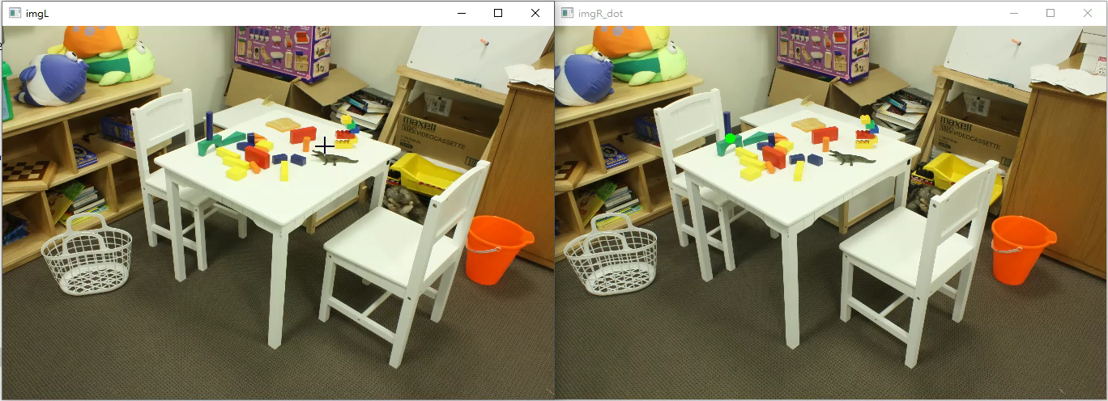
4.2 (10%) Checking the Disparity Value
(出題：Maton)
Given: a pair of images, imL.png and imR.png and disparity map from Q4.1.
Q:
Click at left image and draw the corresponding dot at right image.
1) Click at left image and draw the dot on the right image at accurate position.
2) User should allow to repeat 1).
Note: Click at gray position at disparity map result from Q.4.1, ignore the position with 0 disparity(e.g. Failure case).
Result Video:

Slide 20
5. Train a Cat-Dog Classifier Using ResNet50 (20%)
(出題：Benjamin)
5.1 (3%) Load the dataset and resize images
5.2 (3%) Plot class distribution of training dataset
5.3 (3%) Show the structure of ResNet50 model
5.4 (3%) Set up 2 kinds of loss functions to train 2 ResNet50 models
5.5 (4%) Compare the accuracies of 2 ResNet50 models on validation dataset
5.6 (4%) Use the better-trained model to run inference and show the predicted class label

Slide 21
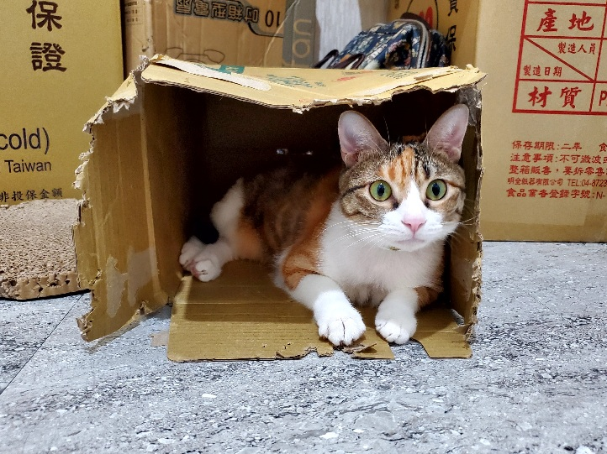
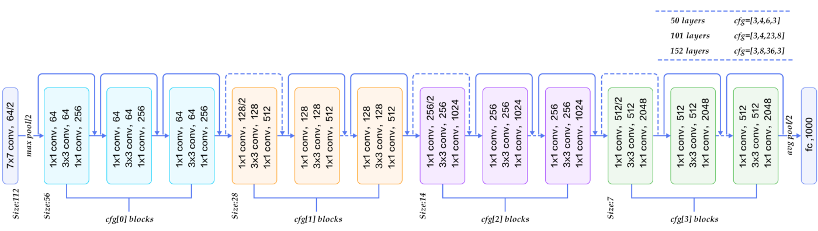
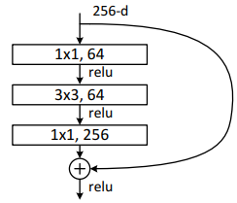
5.0 Train a Cat-Dog Classifier Using ResNet50
(出題：Benjamin)
Objective
Learn how to train a ResNet50 model to classify images of cats and dogs
Learn how to deal with imbalanced data
ResNet50
Residual learning: avoid degradation problems
Bottleneck: build a deeper network without additional parameters
Cats and Dogs Dataset (modified from Kaggle Cats and Dogs Dataset)
Data type: JPG images
2 classes: Cat and Dog
Datasets
Path: /Download/Homework/Hw2/Dataset_OpenCvDl_Hw2_Q5.zip
Training dataset: 16,200 JPG images in total. However, the dataset is imbalanced.
Validation dataset: 1,800 JPG images in total.
Inference dataset: 10 JPG images in total. It is for testing the inference function in your GUI program.
Input: an RGB image 224×224×3c
112×112×64c
3×3
/2: stride = 2
56×56×256c
×3
Every conv layer is followed by a BN layer and a ReLU layer
28×28×512c
×3
BN: Batch Normalization
ReLU: Rectified Linear Unit
×5
14×14×1024c
×2
7×7×2048c
R. Reference
Deep Residual Learning for Image Recognition
Kaggle Cats and Dogs Dataset
global avg pool
FC, 1c
FC: fully connected
Figure: Residual Block (with bottleneck)
Output: a confidence value (range: 0 ~ 1)
Figure: ResNet50 model structure

Slide 22
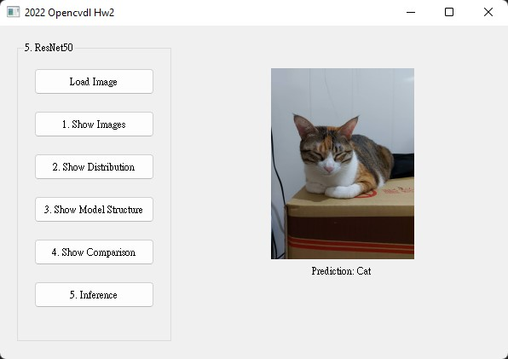
5.0 Train a Cat-Dog Classifier Using ResNet50
(出題：Benjamin)
Requirements
Train ResNet50 models with TensorFlow or PyTorch
Every chart should have a chart title and axis titles
Organize the files in this structure:
Hw2_05_StudentID_Name_Version // project folder
|-- model // folder to put trained models
|-- inference_dataset
|-- Cat
|-- Dog
|-- main.py // codes for your GUI program
|-- train.py // codes for model training
|-- ⁞ // other files or folders you need
Notice: Please include the inference dataset in your homework file.
Figure: GUI example

Slide 23
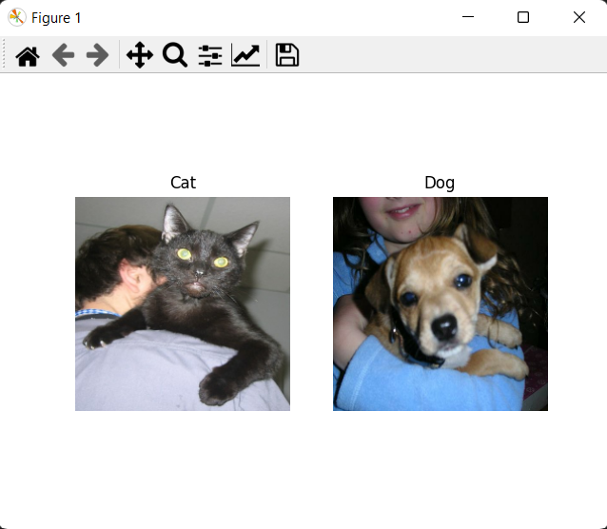
5.1 (3%) Load the dataset and resize images
(出題：Benjamin)
Objective
At home:
Load the training dataset and validation dataset
→ Hint:
(a) TensorFlow (tutorial): tf.keras.utils.image_dataset_from_directory()
(b) PyTorch (tutorial): torch.utils.data.Dataset
Resize images to 224×224×3c (RGB)
→ Hint:
(a) TensorFlow: tf.keras.utils.image_dataset_from_directory(image_size=(?, ?))
(b) PyTorch (tutorial): torchvision.transform
When the demo:
Click the button “1. Show Images”
Load the inference dataset
Resize images to 224×224×3c (RGB)
Get 1 image from each class in the inference dataset
Show images in a new window
→ Hint: use matplotlib.pyplot functions to show images (tutorial):
(a) figure()
(b) imshow()
(c) subplot()
(d) title()
Figure: 1 image from each class
Notice: this is an example, the images might differ

Slide 24
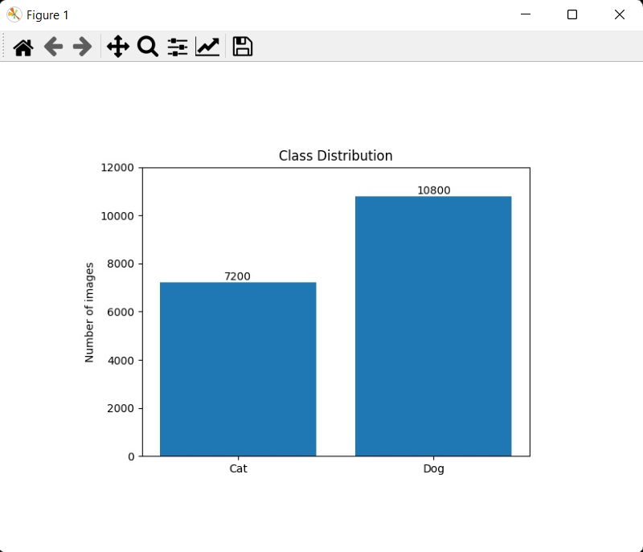
5.2 (3%) Plot class distribution of training dataset
(出題：Benjamin)
Objective
At home:
Load the training dataset
Iterate through the dataset and count the number of images of each class
Plot the class distribution
→ Hint: use matplotlib.pyplot functions to plot
(a) figure()
(b) bar()
(c) xticks()
(d) ylabel()
Save the figure
When the demo:
Click the button “2. Show Distribution”
Show the saved figure of class distribution in a new window
Figure: Class Distribution
Notice: this is an example, the numbers might differ

Slide 25
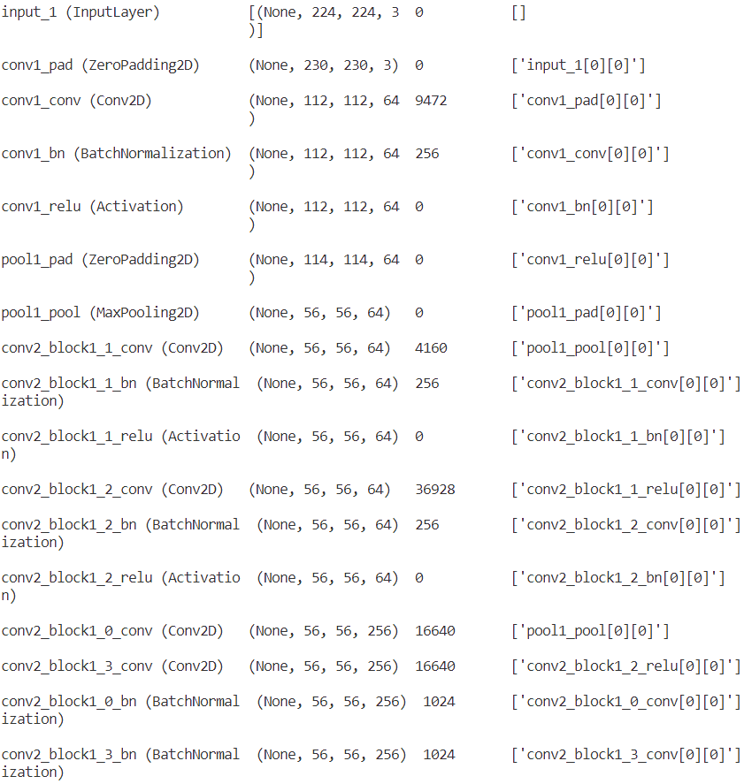
5.3 (3%) Show the structure of ResNet50 model
(出題：Benjamin)
Objective
At home:
Build a ResNet50 model
→ Hint:
(a) TensorFlow: tf.keras.applications.resnet50.ResNet50()
(b) PyTorch: torchvision.models.resnet50()
Replace the output layer to a FC (Fully Connected) layer of 1 node with a Sigmoid activation function
→ Hint:
(a) TensorFlow (tutorial): tf.keras.layers.Dense(1, activation=‘sigmoid’)
(b) PyTorch (tutorial): torch.nn.Linear(2048, 1), torch.nn.Sigmoid
If the class label of Cat is 1, the output value (range: 0 ~ 1) should be close to 1 for cat images, and vice versa.
Run the function to show the structure in the terminal
→ Hint:
(a) TensorFlow: tf.keras.Model.summary()
(b) PyTorch: torchsummary
When the demo:
Click the button “3. Show Model Structure”
Run the function to show the structure in the terminal
Feature map shape
(B, H, W, C)
Num. of param.
Layer (type)
Layer connecting to
Figure: the structure of ResNet50 model

Slide 26
5.3 (3%) Show the structure of ResNet50 model
(出題：Benjamin)
How to read the structure
Input: an RGB image 224×224×3c
Feature map shape
(B, H, W, C)
Num. of param.
Layer (type)
Layer connecting to
112×112×64c
3×3
/2: stride = 2
56×56×256c
×3
Every conv layer is followed by a BN layer and a ReLU layer
28×28×512c
×3
BN: Batch Normalization
ReLU: Rectified Linear Unit
×5
14×14×1024c
Figure: the structure of ResNet50 model
×2
7×7×2048c
global avg pool
FC, 1c
FC: fully connected
Output: a confidence value (range: 0 ~ 1)

Slide 27
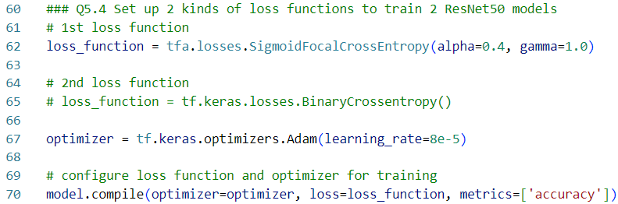
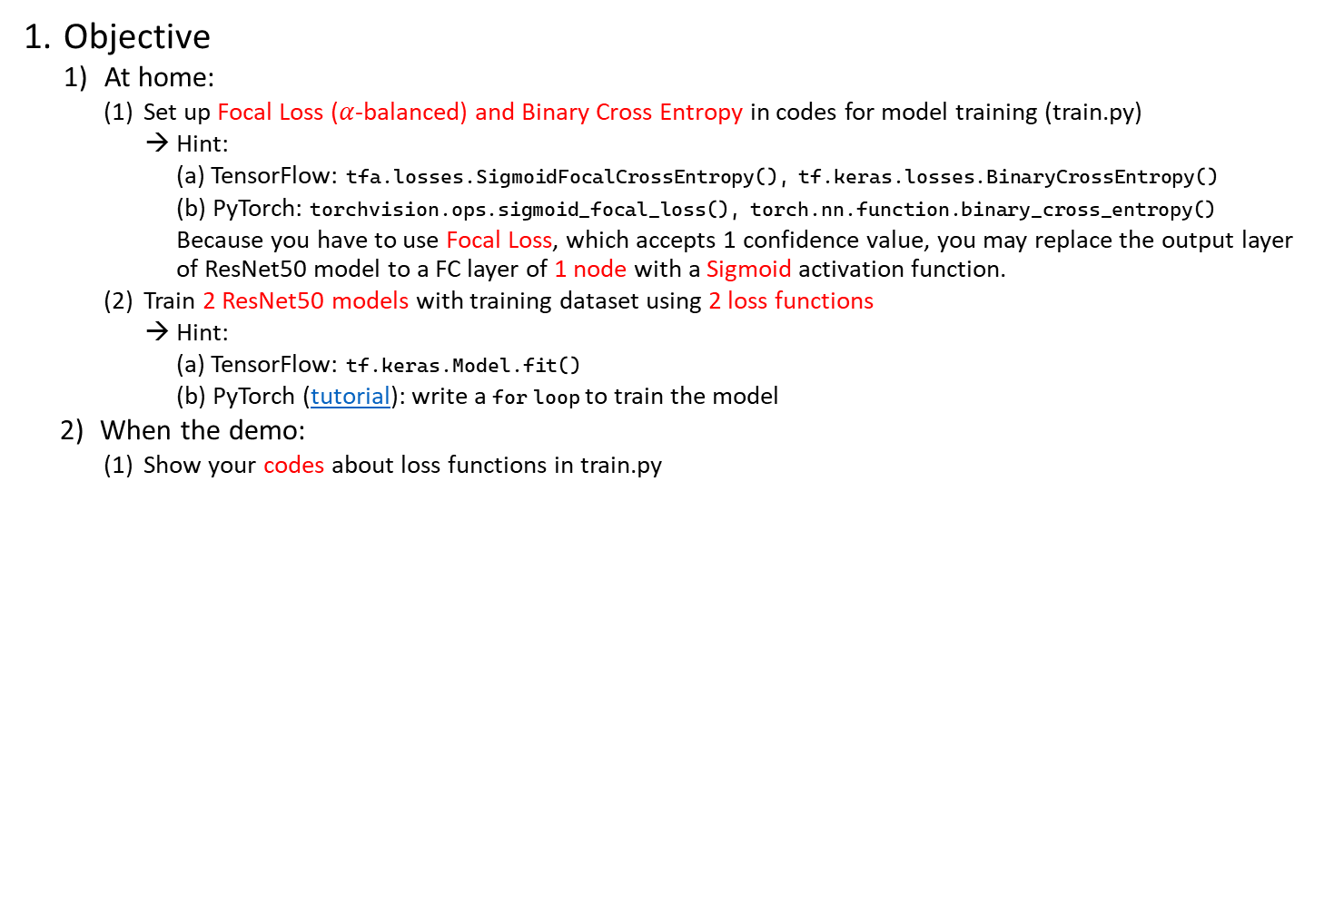
5.4 (3%) Set up 2 kinds of loss functions to train 2 ResNet50 models
(出題：Benjamin)
Objective
At home:
Set up Focal Loss ($α$-balanced) and Binary Cross Entropy in codes for model training (train.py)
→ Hint:
(a) TensorFlow: tfa.losses.SigmoidFocalCrossEntropy(), tf.keras.losses.BinaryCrossEntropy()
(b) PyTorch: torchvision.ops.sigmoid_focal_loss(), torch.nn.function.binary_cross_entropy()
Because you have to use Focal Loss, which accepts 1 confidence value, you may replace the output layer of ResNet50 model to a FC layer of 1 node with a Sigmoid activation function.
Train 2 ResNet50 models with training dataset using 2 loss functions
→ Hint:
(a) TensorFlow: tf.keras.Model.fit()
(b) PyTorch (tutorial): write a for loop to train the model
When the demo:
Show your codes about loss functions in train.py
Train a model with Focal Loss
Train another model with Binary Cross Entropy
Figure: Code example (you can follow the hyperparameter settings)

Slide 28
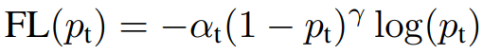
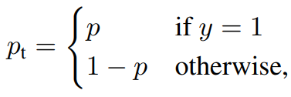
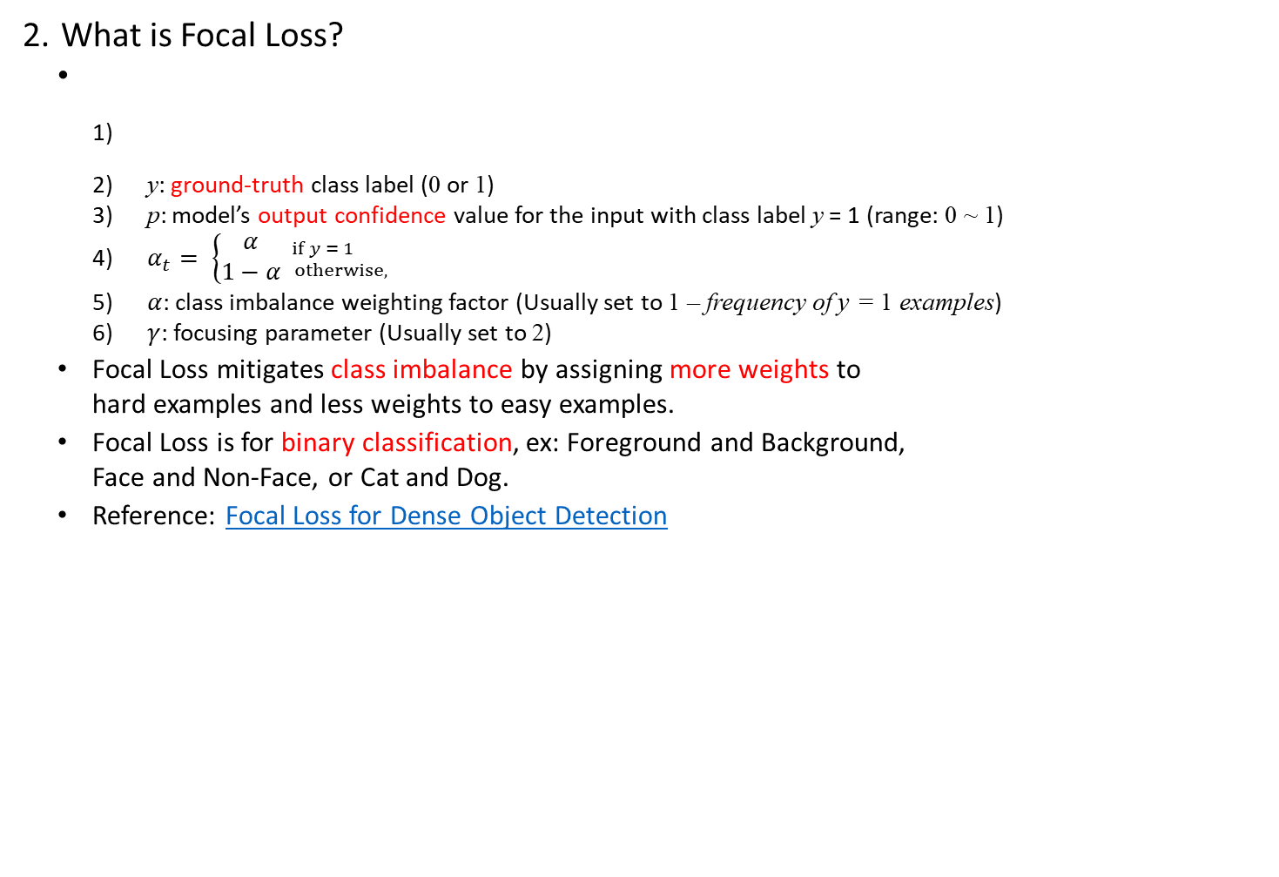
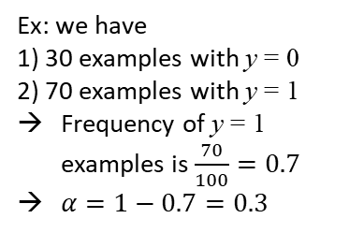
5.4 (3%) Set up 2 kinds of loss functions to train 2 ResNet50 models
(出題：Benjamin)
What is Focal Loss?
y: ground-truth class label (0 or 1)
p: model’s output confidence value for the input with class label y = 1 (range: 0 ~ 1)
$α_{t}= \left\{\begin{aligned}α \\ 1−α\end{aligned}{if y = 1 \atop otherwise,}\right.$
$α$: class imbalance weighting factor (Usually set to 1 – frequency of y = 1 examples)
$γ$: focusing parameter (Usually set to 2)
Focal Loss mitigates class imbalance by assigning more weights to hard examples and less weights to easy examples.
Focal Loss is for binary classification, ex: Foreground and Background, Face and Non-Face, or Cat and Dog.
Reference: Focal Loss for Dense Object Detection
Ex: we have
1) 30 examples with y = 0
2) 70 examples with y = 1
Frequency of y = 1 examples is $\frac{70}{100}=0.7$
$α=1−0.7=0.3$

Slide 29
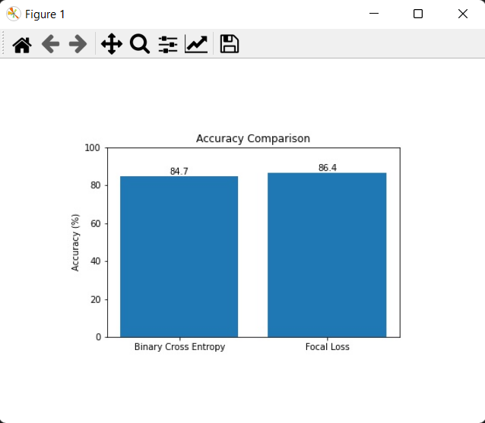
5.5 (4%) Compare the accuracies of 2 ResNet50 models on validation dataset
(出題：Benjamin)
Objective
At home:
Validate 2 ResNet50 models with validation dataset
→ Hint:
(a) TensorFlow: tf.keras.Model.evaluate()
(b) PyTorch (tutorial): write a for loop to validate the model
Plot the accuracy values with a bar chart
Save the figure
When the demo:
Click the button “4. Show Comparison”
Show the saved figure of class distribution in a new window
Figure: Accuracy Comparison
Notice: this is an example, the numbers might differ

Slide 30
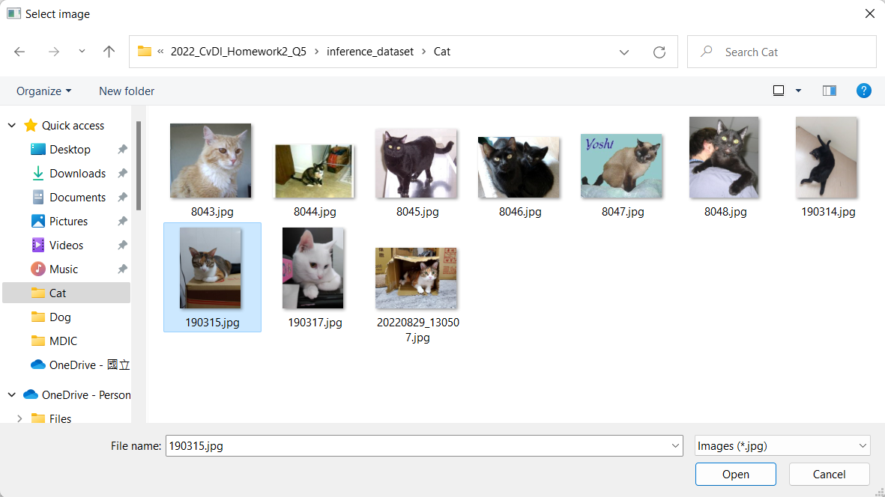
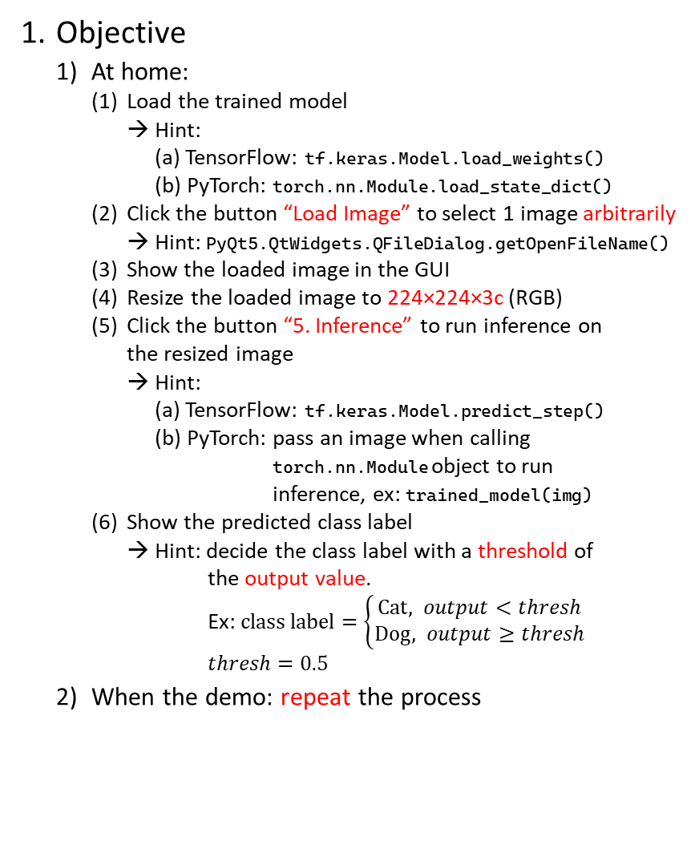
5.6 (4%) Use the better-trained model to run inference and show the predicted class label
(出題：Benjamin)
Objective
At home:
Load the trained model
→ Hint:
(a) TensorFlow: tf.keras.Model.load_weights()
(b) PyTorch: torch.nn.Module.load_state_dict()
Click the button “Load Image” to select 1 image arbitrarily
→ Hint: PyQt5.QtWidgets.QFileDialog.getOpenFileName()
Show the loaded image in the GUI
Resize the loaded image to 224×224×3c (RGB)
Click the button “5. Inference” to run inference on the resized image
→ Hint:
(a) TensorFlow: tf.keras.Model.predict_step()
(b) PyTorch: pass an image when calling torch.nn.Module object to run inference, ex: trained_model(img)
Show the predicted class label
→ Hint: decide the class label with a threshold of the output value. Ex: $class label=\left\{\begin{aligned}Cat, output<thresh \\ &Dog, output≥thresh\end{aligned}\right.$
$$thresh=0.5$$
When the demo: repeat the process
(2) Select 1 image arbitrarily
(3) Show the loaded image
(4) Resize the loaded image to 224×224×3c
(2) Select 1 image arbitrarily
(6) Show the predicted class label
(5) Run inference on the loaded image

